Slide 1
NLP: Let the Machine Do the Reading
Question Answering

Slide 2

Overview
Asking a question to a machine and receiving an answer was always the stuff of sci-fi in the not too distant past. Now, things have changed, and we find ourselves using Q&A systems everywhere.
By the end of this week you will be able to:
Identify the key concepts of a Q&A task in NLP
Understand LayoutLM model architecture
Fine-tune BERT for QA task

Slide 3
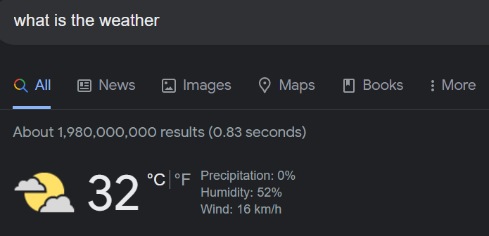
Introduction
Question Answering is the task of answering questions, typically reading comprehension questions...
but abstaining when presented with a question that cannot be answered based on the provided context!
Google search is the best example where you can get a direct answer or get pointed in the right direction to find the answer.

Slide 4
How does a QA task works?
In Question Answering tasks, the model receives a question regarding text content and is required to mark the beginning and end of the answer in the text.
If we have a very large set of such texts together with sample questions and the position of the answers in the text, we can train a neural network to learn relationships between context, questions, and answers. The resulting network would be able to answer unseen questions given new contexts which are similar to the training texts.

Slide 5
QA with BERT
BERT takes the input question and passage (content) as a single packed sequence
The input embeddings are the sum of the token embeddings and the segment embeddings.
The input is processed in the following way before entering the model:
Token embeddings
Segment embeddings
Mask tokens
Position embeddings

Slide 6
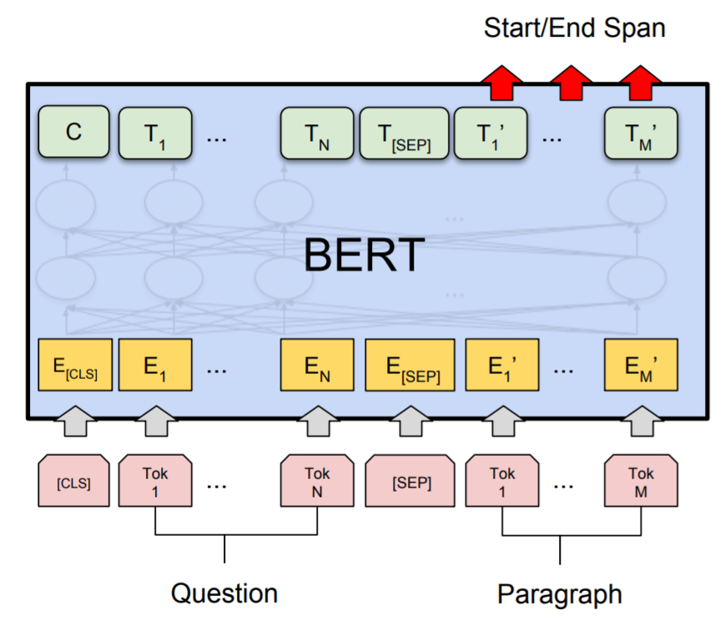
QA with BERT

Slide 7
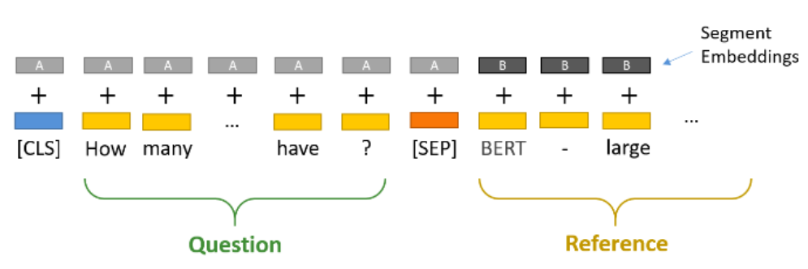
QA with BERT
Token embeddings:
A [CLS] token is added to the input word tokens at the beginning of the question and a [SEP] token is inserted at the end of both the question and the paragraph.
Segment embeddings:
A marker indicating Sentence A or Sentence B is added to each token. This allows the model to distinguish between sentences. In the below example, all tokens marked as A belong to the question, and those marked as B belong to the paragraph.

Slide 8
QA with BERT
To fine-tune BERT for a Question-Answering system, it introduces a start vector and an end vector. The probability of each word being the start-word is calculated by taking a dot product between the final embedding of the word and the start vector, followed by a softmax over all the words. The word with the highest probability value is considered.
A similar process is followed to find the end-word.

Slide 9
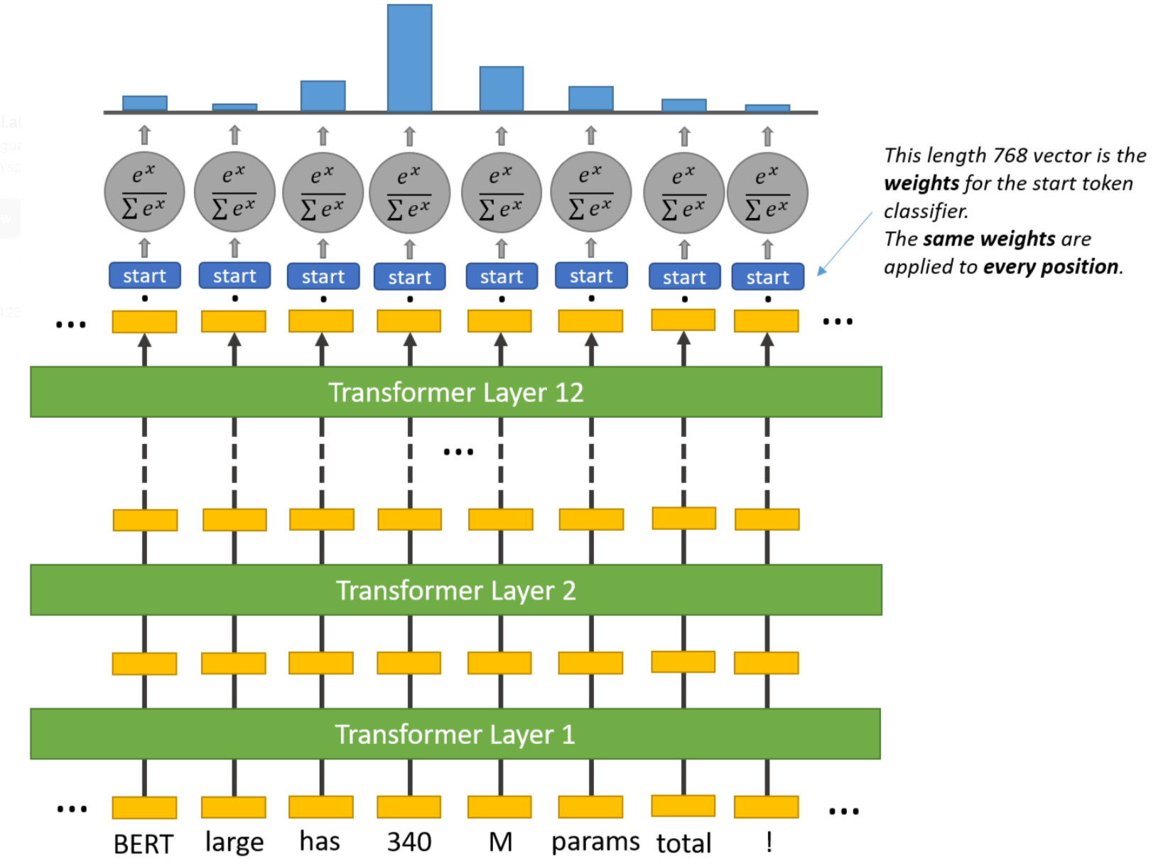
QA with BERT

Slide 10
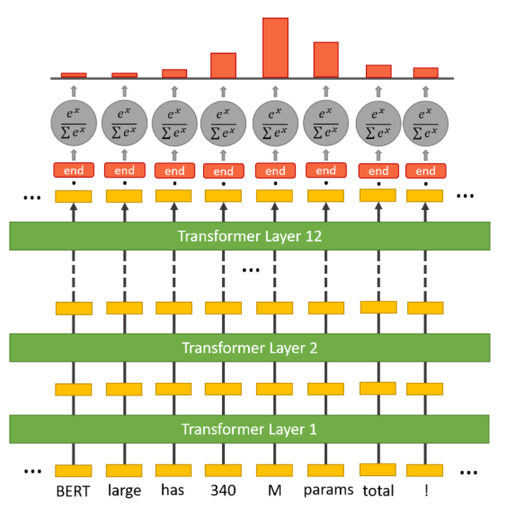
QA with BERT

Slide 11
The SQuAD Dataset
Stanford Question Answering Dataset (SQuAD) is a reading comprehension dataset, consisting of questions posed by crowdworkers on a set of Wikipedia articles, where the answer to every question is a segment of text, or span, from the corresponding reading passage, or the question might be unanswerable.
https://rajpurkar.github.io/SQuAD-explorer/

Slide 12
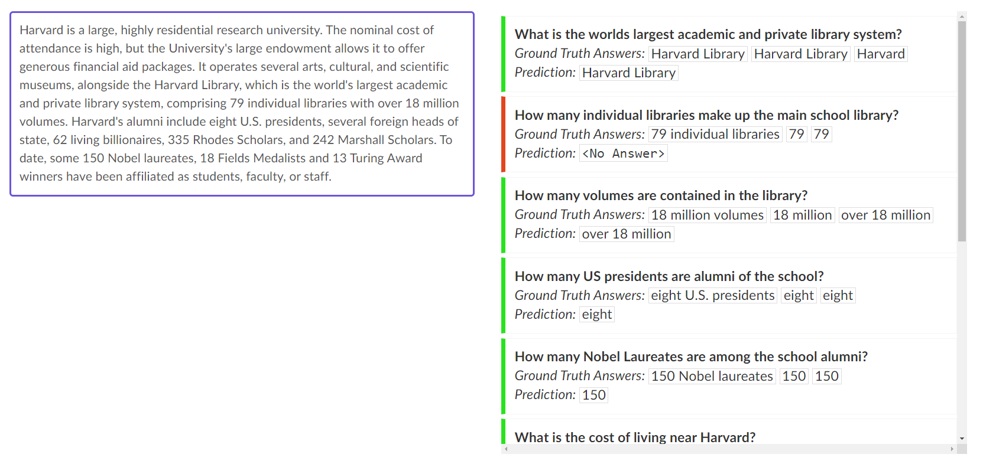
The SQuAD Dataset - Predictions by BERT Model

Slide 13
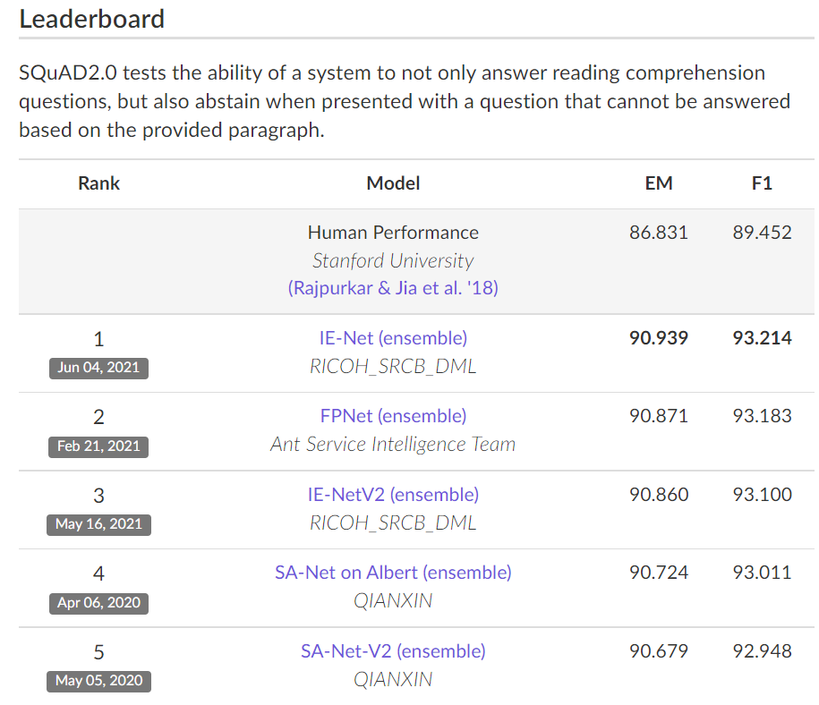
The SQuAD Dataset - Leaderboard

Slide 14
References & Links
BERT paper: https://arxiv.org/pdf/1810.04805.pdf
The Illustrated BERT by Jay Alammar: https://jalammar.github.io/illustrated-bert/
SQuAD paper: https://arxiv.org/pdf/1606.05250.pdf
Hugging Face models: https://huggingface.co/models
Paper on fine-tuning BERT for QA https://arxiv.org/pdf/2011.07208.pdf

